Slide 1
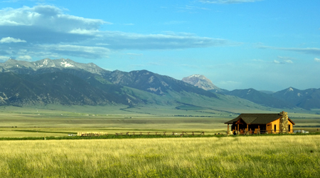
TEMPERATE GRASSLAND BIOME
SEMESTER VI (HONS.)
DSE-4
Dr. Sujata Das
Deptt. Of Geography
Hooghly Women’s College

Slide 2
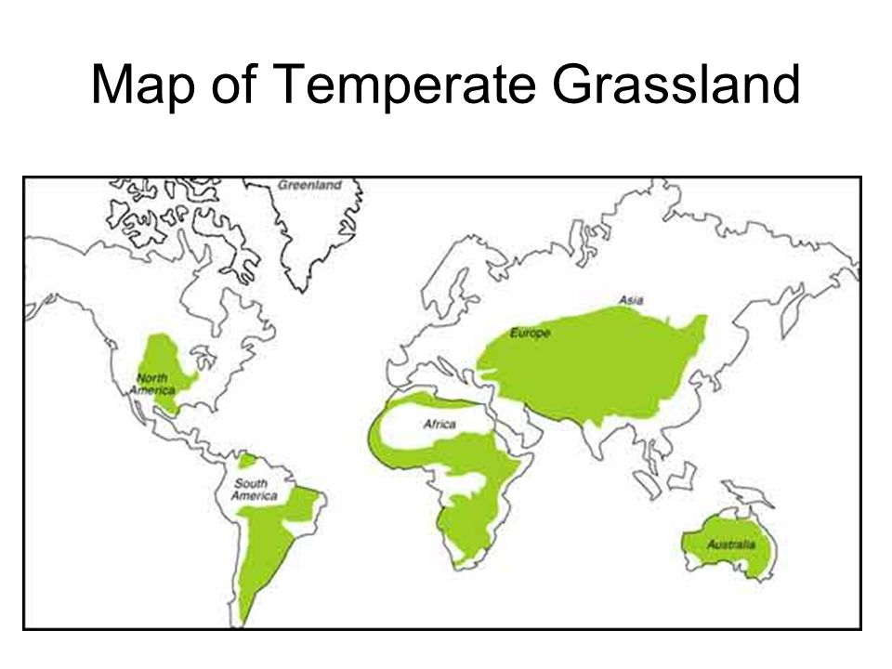
TEMPERATE GRASSLAND BIOME
Location Interiors of continents in the westerly wind belt
Steppes in Eurasia, Prairies in U.S.A & Canada, Manchurian Grasslands in
Manchuria, Pustaz in Hungary, Pampas in Argentina & Uruguay, Bush Veld &
High Veld in South Africa, Downs of Murray-Darling Basin of South Eastern
Australia & Canterbury Grassland of New Zealand

Slide 3
Climate Mean annual rainfall 25cm to 75cm; mostly received in summer
Snowfall occurs during winter in Northern Hemisphere
Warm summers more than 20⁰c ; cold winters of 1⁰c to 12⁰c in Southern
Hemisphere (S.H) & less than 0⁰c temperature in Northern Hemisphere(N.H)
Annual temp range 40⁰c in N.H & 10⁰c to 12⁰c in S.H

Slide 4
Vegetation
Grasses belonging to GRAMINAE family are dominant
Single layered structure of vegetation
Eurasian Steppes extends from eastern Europe to western Siberia a) Forest Steppes consist of trees mainly Oak, Mapple, Birch, Aspen & Willow alternate with open Steppe developed over degraded Chernozem soils b) Meadow Steppes are open Steppes between woodland zones of Forest Steppe characterised by growth of turf grasses like Stipa & Fescue & flowering plants such as
Trifolium & Daisy developed over well formed Chernozem soils c) Grass Steppes are dominated by grasses, Stipa, a few flowering xerophytic shrubby species of Artemisia developed over deep Chernozem soils

Slide 5
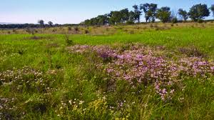
d) Semi-arid Xerophytic Steppes found in extreme southern and south- western parts where xerophytic grasses like Fescue & Feather grass & xerophytic species of Artesia thrive over Chestnut soil

Slide 6
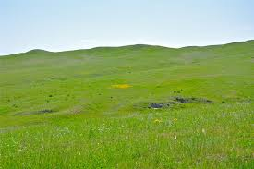
North American Prairies are found in the U.S. A & Canada between the foothills of the
Rockies in the west & the Temperate Deciduous forest biome in the east a) Tall Grass Prairie is found in the eastern part of the Prairies where dominant species are Bluestem & Switch grasses of height 1.5m to 2.5m b) Mixed Prairie extends between the U.S. A-Canada border in the north & Texas in the south. Dominant species are medium grasses of height 0.6m to
1.2m little Bluestem, Needlegrass, Junegrass; short grasses like Buffalograss &
Blue gramma c) Short Grass Prairie is found in the western part of the Great Plains & is dominated by short grasses of height of about 0.6m

Slide 7
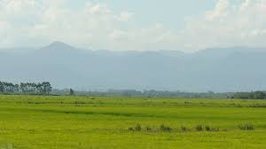
South American Pampas are found in 15% of total area of Argentina a) Humid Pampas are found in eastern part of Argentina; characterised by tall grasses. b) Sub-humid Pampas are found in the western part of Argentina: characterised by short grasses.
Important species of grasses are Briza, Bromus, Panicum,Paspalam, Lolium etc.
Man has introduced Lucerne plant belonging to leguminous species; used as food for animals .

Slide 8
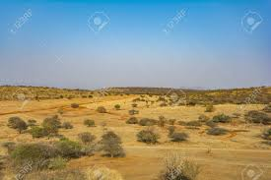
African Veld has developed on plateau land of south-eastern Africa. a) Themeda Veld is found at an altitude ranging from 1500m to 1700m where mean annual precipitation is 65 to 75 cm. Red Grasses is the dominant species b) Sour Veld represents those areas of Themeda Veld which are dominated by less important grasses like Aristida, Eragrostis & Hyparrhenia c) Alpine Veld is found over relatively higher altitudes of 2000m to 2500m of
Drakensberg Mt. where Themeda grasses are mixed with Festica & Bromus

Slide 9
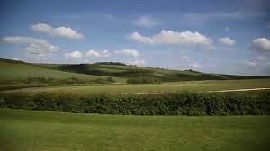
Australian Downs have developed in the south-eastern parts of Australia & northern part of
Tasmania. a) Temperate Tall Grasslands have developed in a region which extends from the eastern coastal lands of New South Wales to Victoria and eastern Tasmania; important grasses are Pota tussock , Danthonia pallida & Themeda australia (Kangaroo grass). b) Temperate Short Grasslands are found parallel to but north of the above type: important grasses are Danthonia & Stipa. c) Xerophytic Grasslands are developed over further northern areas such as the interior lands of New South Wales & Queensland with grasses like Aristida & Mulga.

Slide 10
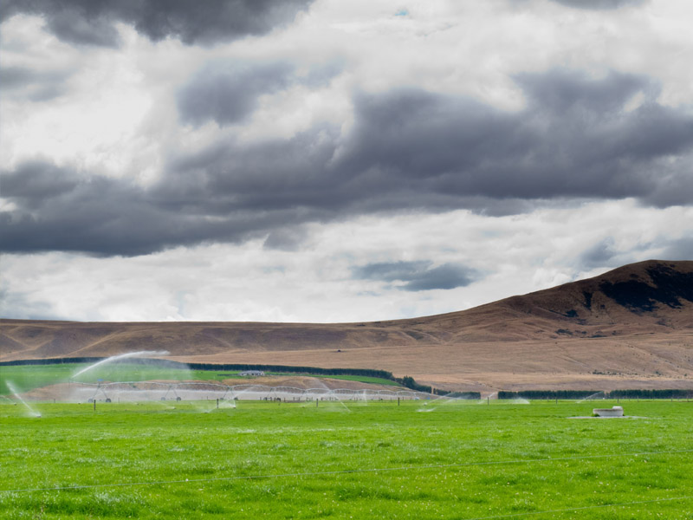
Canterbury Grasslands of New Zealand are developed in the eastern part of the southern island & the central part of the northern island of New Zealand . a) Short Tussock grasses having main species of Festuca & Poa b) Tall Tussock grasses having main species of Chinomechloa having developed over higher grounds

Slide 11
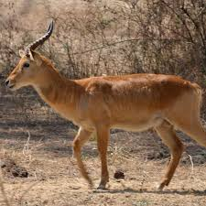
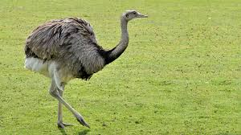
Animal Life a) Eurasian Steppes: main species are Saiga Antelopes, Mongolian Gazelles & rare species of wild horses of the ungulate category, Mole Rats, wolves,
Eagles, Hawks , Polecat etc. b) North American Prairies: main species are Bisons, Pronghorns, Gophers,
Prairie Dogs, Hawks, Eagles, Wolves, Rattle Snakes, Foxes etc. all adversely affected by overexploitation of these grasslands by man c) South American Pampas: main species are Pampa Deer, Viscacha, Mara; birds like Rhea (flightless), Herons, Geese, Ducks etc.

Slide 12
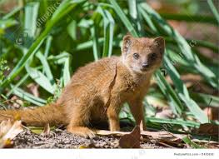
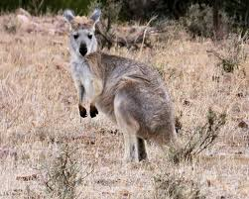
d) African Veld: main species which dominated the area were Antelopes,
Hyenas, Jackals, Lions, Leopards , Zebra etc. but have now been replaced by domesticated animals like Cattle, Sheep, Goats: birds, rodents like
Springhare & Gerbil, carnivorous animal like Yellow Mongoose etc. e) Australian Downs : main species are 3 types of Kangaroos like Red
Kangaroos, Grey Kangaroos, Wallaroos; flightless bird like Emu; European
Rabbits & Sheep have been introduced later on f) Canterbury Grasslands of New Zealand: main species was giant flightless bird Moas but they have disappeared due to large scale hunting by man; almost absence of herbivores because of the isolated status of this island

Slide 13
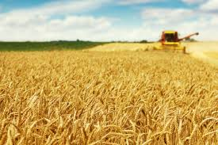
Anthropogenic Impact
Conversion of grasslands into agricultural farmlands >“granaries of the world”
Obliteration of natural habitats of species
Disappearance & extinction of species >Bisons, Pronghorns are facing imminent extinction;
Large scale hunting ; animals like Antelopes, Hyenas, Jackals, Lions,
Leopards , Zebra etc. but have now been eliminated
Introduction of new species like Sheep, European Rabbits etc. changed the composition of native animal life & vegetation

Slide 14
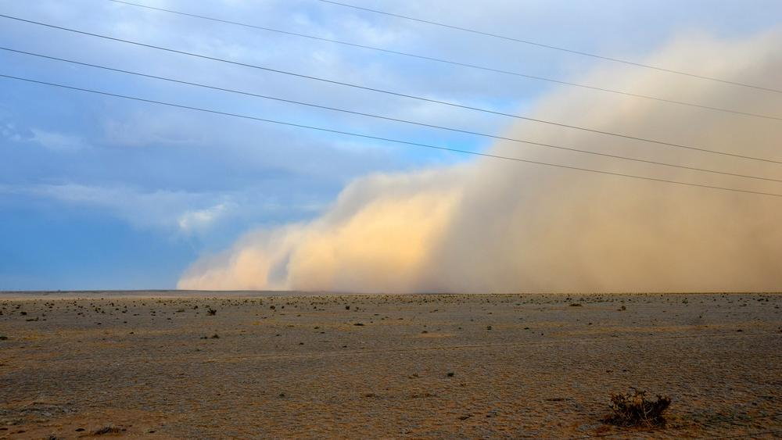
Introduction of new species of plants has suppressed the native natural vegetation or has eliminated many plant species (like leguminous plants like Clover & grasses like Bromus, Hardeum & Ryegrass in
Downs)
Removal of natural vegetation have loosened soil cover resulting into soil accelerated rate of soil erosion & loss of fertile soils & created “dust bowls”

Slide 15
Protection
The Temperate Grasslands Conservation Initiative (TGCI) strives to meet 17% protection of terrestrial lands by 2020. Some of the priority regions of the action group are:
Prairie grasslands, Pampas grasslands, parts of Steppes ,
Veld of southern Africa, Lowland grasslands of southeastern Australia,
Tussock grasslands of New Zealand

